Slide 1

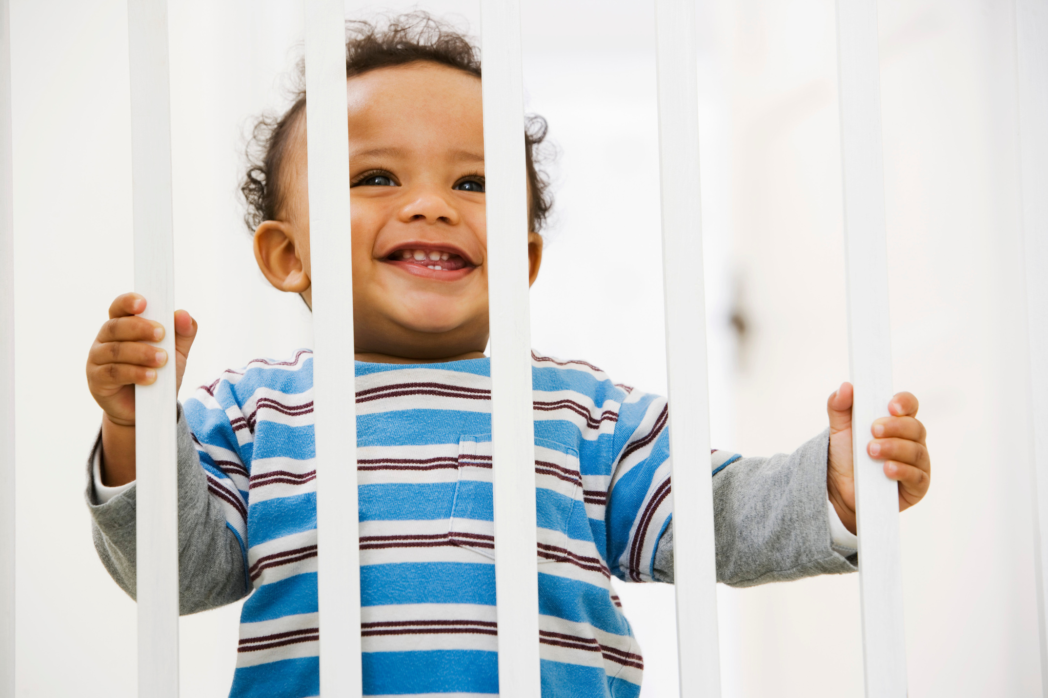
Child Fall Prevention
A Focus on Baby Gates
November 2025
Notes:
Hello and welcome to today's presentation on child fall prevention and home safety, focusing on the safe use of baby gates.

Slide 2



Land Acknowledgement
Acknowledgement of Mi'kmaw Territory
We would like to begin by acknowledging that we are in Mi’kma’ki, the traditional and unceded territory of the Mi’kmaq people.
We are all Treaty people who benefit greatly from the shared resources of this land covered by the treaties of Peace and Friendship.
Notes:
Before we begin, I would like to take a moment to acknowledge the land we are on.
[Please customize the information on the slide as needed to reflect the specific Indigenous communities and territories relevant to the location you are located]

Slide 3




About Child Safety Link
Mission: To reduce the incidence and severity of unintentional injuries to children and youth in the Maritimes (Atlantic when appropriate).
PRIORITY FOCUS
AT HOME
AT PLAY
ON THE ROAD
AT SCHOOL
Notes:
This presentation was created by Child Safety Link to help prevent falls and promote safety at home.
Child Safety Link’s mission is to reduce the number and severity of unintentional injuries to children and youth in the Maritimes, and Atlantic when appropriate.
Their focus areas include keeping children safe at home (which we’ll cover today), at play, on the road, and at school.

Slide 4




Safety At Home: Fall Prevention
Safety at Home:
Children spend a lot of time at home, and many injuries that happen there can be prevented.
Today we’ll talk about:
Childhood falls
Baby gates
Baby gate safety
Notes:
Children spend a significant amount of time at home and due to this it is a common place where injuries can occur.
The good news is that many of these injuries can be prevented with the right safety measures in place. One essential tool for keeping children safe at home is baby gates.
In today’s presentation, we will focus on the importance of using baby gates safely. We’ll discuss why they matter, how to install them properly, and how they can protect your child from injury in different areas of your home.

Slide 5

Discussion
Question
Have you thought about ways to keep your
child safe from falls at home?
Notes:
Before we dive in, I want to start with a question: Have you thought about ways to keep your child safe from falls at home?
Take a moment to think about it, and feel free to share your thoughts.
(Pause for responses)
It’s perfectly normal if you haven’t thought much about this yet! With all the exciting milestones your child is reaching—learning to crawl, walk, and explore—it’s natural to focus on their development. You’re not alone in that. Many parents are in the same place, and today we’ll talk about how you can help keep your kids while they continue to grow and explore.
We’ll discuss some ways to reduce the risk of falls while still allowing your child to explore safely. Let’s get started!

Slide 6

Child Falls
Notes:
Let's begin our first topic – falls.

Slide 7
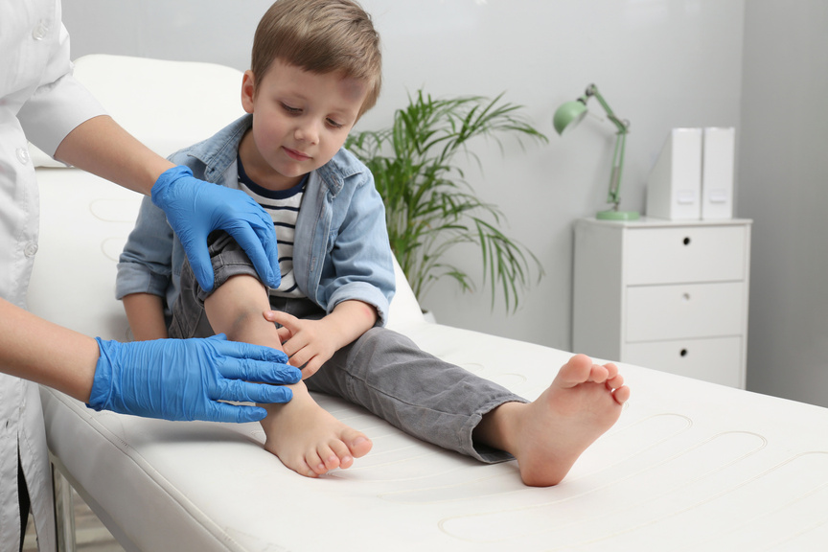
Why are child falls an issue?
In Canada, falls are the main reason children under 14 go to the hospital for injuries
Notes:
You may be wondering, why are child falls an issue?
In Canada, falls are the main reason children under 14 go to the hospital for injuries. As we talk about fall prevention today, it’s important to recognize just how common these incidents can be.

Slide 8



Child Fall Statistics
In one year (2018), falls in Atlantic Canada resulted in:
19,366 visits to the emergency department
354 hospitalizations
98 disabilities
Notes:
In 2018 alone, falls in Atlantic Canada resulted in:
354 hospitalizations
98 disabilities
19,366 visits to the emergency department
$52 million in healthcare costs
These numbers are based on the most recent available data.

Slide 9

The Impact of Falls
Falls are a normal part of childhood, but some falls can cause serious harm.
Small bumps and bruises are normal and not serious harm
Some falls can lead to serious injuries that may need medical attention or lead to long term health issues
Kids' curiosity and small size put them at higher risk for serious falls
Notes:
As children grow and become more independent, it is normal for them to experience falls while exploring their surroundings.
While most falls result in minor injuries like cuts and bruises, some can cause serious harm that may require hospitalization or even be fatal.
Children are especially vulnerable to injuries due to their small size and on-going development. Their natural curiosity – crawling, tasting, touching – also increases their risk of falls and injury.
This is concerning as serious fall-related injuries, particularly to the head and neck, can lead to lifelong negative health outcomes.

Slide 10
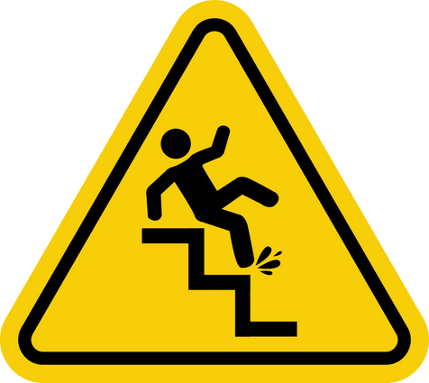

Risks and Hazards
Risk
Hazard
A challenge that a child can recognize and decide how to handle based on
their skills.
A danger that a child cannot recognize or handle safely.
Notes:
Now that we've looked at how falls happen and the impact they can have, let's talk about two important ideas that help us understand child safety at home: risks and hazards.
A risk is a challenge that a child can recognize and decide how to handle based on their skills. As children grow older what is considered a risk may change.
A hazard is a danger that a child cannot recognize or handle safely.
Baby gates help prevent hazards by blocking access to areas that are too dangerous for young children to navigate on their own, like stairs, fireplaces, and kitchens. These are hazards because young children cannot understand or manage the dangers on their own.
Risk can involve allowing a child to explore new areas or practice going up stairs while being supervised, helping them develop important motor skills.
With a baby gate securely in place, the risk of serious falls is greatly reduced because the gate prevents the child from accessing the stairs unsupervised or before they are developmentally ready.

Slide 11
Beneficial Risks
Create a safe space but allow kids to explore and take healthy risks.
Check your home for hazards while letting kids explore safely
Letting kids take some risks helps them grow and learn
Use safety tools, like baby gates, to reduce hazards, especially around stairs
Notes:
Now that we know some common dangers in the home, it’s important to think about how to make the home safe for kids to explore.
Creating a safe space means looking for dangers in your home, but also letting kids explore safely. When kids take safe risks, it helps them grow and become more independent. Exploring helps them learn what they can do and what they should avoid.
To help keep kids safe, we can use tools like baby gates. Baby gates can stop kids from going near dangers, especially stairs. By putting baby gates in the right places, we can make the home safer while giving kids space to explore.
12

Slide 12
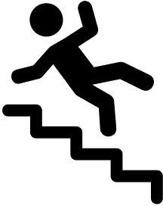
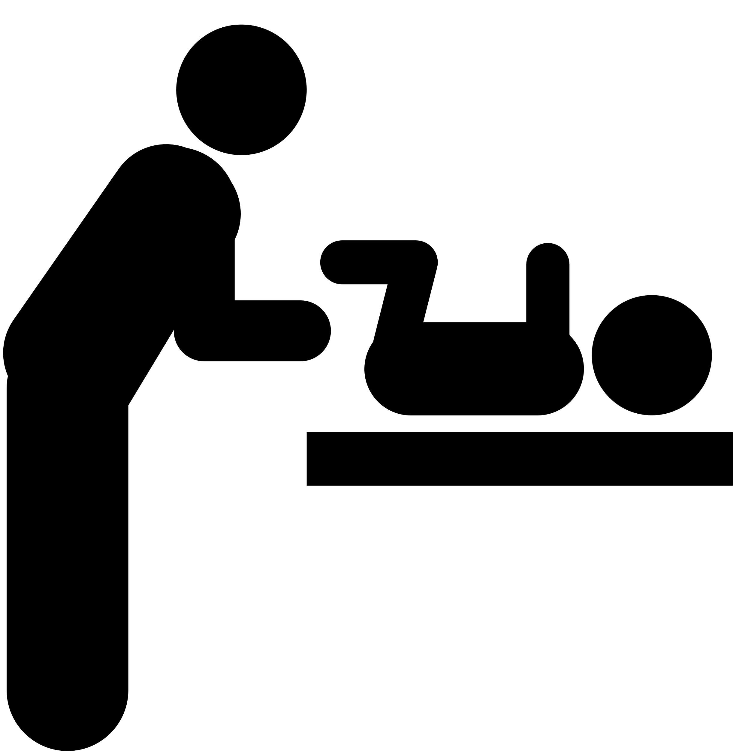
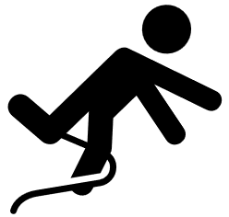
Falls in the Home
The three leading causes of child fall-related injuries at home are:
Falls on Stairs
Falls from Furniture
Same Level Trips
Notes:
As we create safe spaces for exploration, it’s important to recognize the three leading causes of fall-related injuries at home:
Falls on stairs
Falls from furniture - Infants can roll off changing tables, and toddlers can fall from beds or highchairs.
Same-level trips and stumbles - These can happen anywhere in the home, often when children run or play.

Slide 13
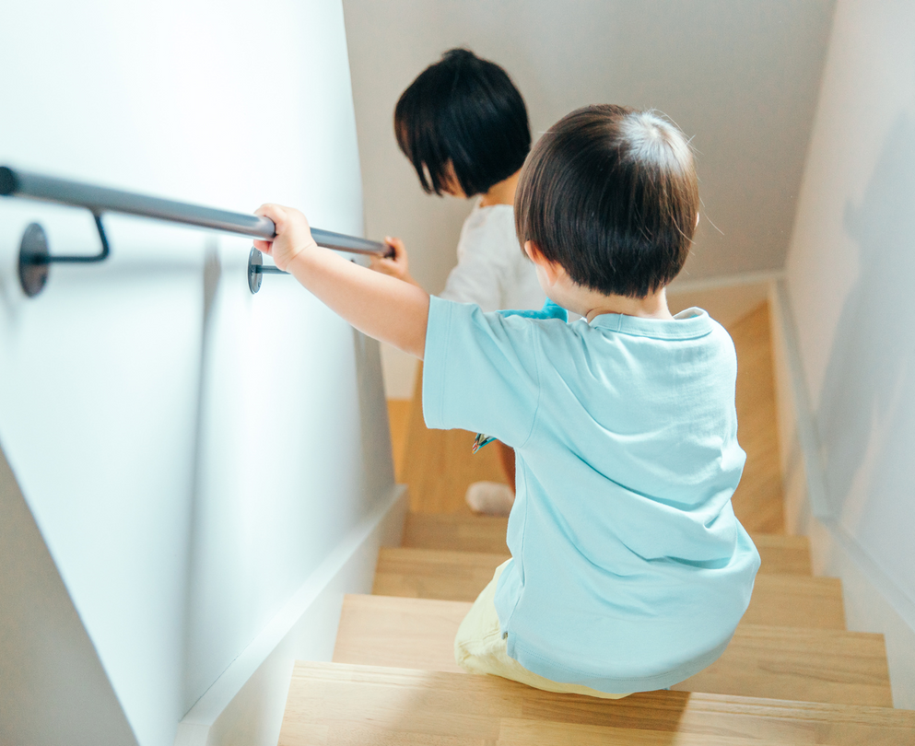
Stair Safety
Supervise children around stairs
Use baby gates at top and bottom
Keep stairs free of clutter
Regularly check for damage and repair
Teach kids safe stair use
Notes:
Lastly, moving on to some general stair safety:
Always supervise children around stairs to ensure their safety.
It is important to use baby gates at both the top and bottom of the stairs to block off access.
Keep stairs free of clutter to reduce the risk of trips and falls.
Regularly check the stairs for any damage and make necessary repairs to keep them safe.
Also, take the time to teach your kids about safe stair use, such as holding onto the railing and taking one step at a time

Slide 14

Baby Gates
Notes:
By understanding the risks of falls and recognizing common hazards, we can create safer environments for children.
Now that we have covered the importance of fall prevention, it’s time to focus on the practical tools that can help reduce these risks. In the following section, we will explore one of the most effective tools for preventing falls in the home: baby gates.
In this section, we will go over how to choose, install, and use baby gates effectively.

Slide 15
Baby Gates
Baby gates keep kids safe when used correctly.
They help prevent falls and keep kids away from hazards
Baby gates set safe boundaries for play and exploring
Baby gates: use from 6 months through 24 months of age, depending on developmental milestones and behaviour
Install a baby gate when you notice your child starting to move independently and crawl
Notes:
Baby gates are important for keeping kids safe. When put up correctly, they can stop falls and keep children away from dangerous areas in the home.
Baby gates help create safe spaces for play and exploration.
Baby gates can block more than just stairs. They can also protect kids from other hazards like kitchens, bathrooms, stoves, fireplaces, and exercise equipment.
Baby gates can also help keep kids safe from things like holiday decorations that could be dangerous.
Baby gates are designed for use with children from around 6 months to 24 months of age, although this can vary depending on individual developmental milestones and behavior. Review the installation manual and safety warnings for more information.
It's a good idea to install a baby gate as soon as you notice your child starting to move independently and crawl. This approach helps create a safer environment before children become more mobile and adventurous!

Slide 16
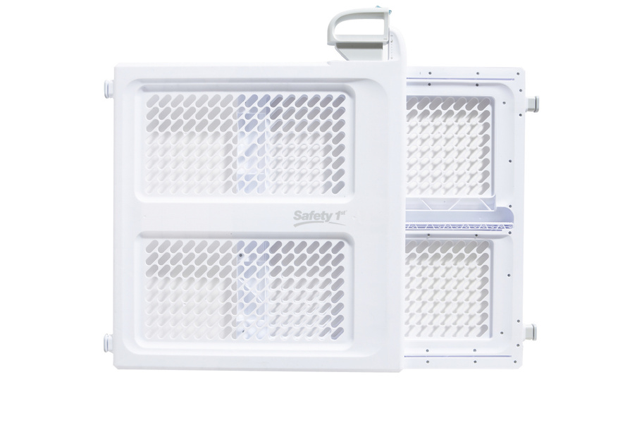
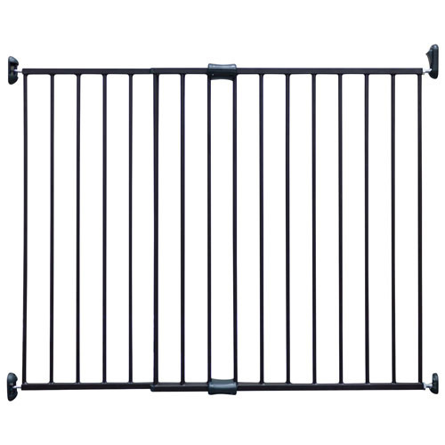
Types of Baby Gates
Hardware Mounted
Baby Gate
Pressure Mounted
Baby Gate
Notes:
When it comes to baby gates, there are two main types to consider: hardware-mounted baby gates and pressure-mounted baby gates. Each type has its own advantages and is suited for different locations. Lets explore!
17

Slide 17
Hardware Mounted Baby Gate
Kept in place by hardware (typically screws)
Mounted in the studs of a wall
Can be used anywhere in the home
The only gates suitable for the top of the staircase
Notes:
Hardware mounted gates are attached to the wall with screws and are generally more secure, making them ideal for areas where maximum safety is required like the top of stairs.
Because they are firmly anchored into the wall, they can withstand more force, which is especially important as children grow and become more active.
These gates are built for long-term use and can be installed in various locations throughout the home.
Importantly, they are the only type recommended for the top of stairs, as their secure installation increases their safety and reduces the risk of falls.

Slide 18
Pressure Mounted Baby Gate
Stays in place with springs or rubber bumpers that press into the wall and lock into place
Best used in same level areas or at the bottom of a staircase
Not safe for the top of the stairs because they can come loose over time
Notes:
Pressure mounted baby gates use tension to stay in place, making them easy to install and remove without damaging walls.
They are ideal for same-level areas, such as doorways and between rooms where a temporary barrier is needed. These gates can also be used at the bottom of a staircase.
However, they are not as secure as hardware-mounted gates, so they are not recommended for the top of stairs or areas where a stronger barrier is necessary. Over time, these gates can come loose and be pushed out of place, making them an unsafe choice for the top of the stairs.

Slide 19

Gates for Unique Spaces
In addition to standard baby gates, there are specialized options designed for unique or irregular spaces within a home, including:
Uneven staircases
Outdoor staircases
Staircases with two railings/bannisters and no wall
Wood stoves and fireplaces
Wide landings or doorways
Notes:
In addition to standard baby gates, there are also specialized options available for unique or irregular spaces within your home. These gates are designed to ensure safety in areas that may not be adequately protected by traditional gates. Some examples include:
Uneven staircases: gates that adjust to different heights and angles.
Outdoor staircases: weather-resistant gates suitable for outdoor use.
Staircases with two railings/bannisters and no wall: gates that can be mounted between railings without needing a wall.
Wood stoves and fireplaces : gates that keep children away from these hazards.
Wide landings or doorways: extra wide gates that can cover larger openings.
These specialized gates are available at most stores that sell baby gates, both online and in-store to fit the needs of your space.

Slide 20

Product Safety
There are safety rules in Canada for many children’s items including baby gates.
Health Canada provides a list of safety alerts and recalls of these children’s items.
On the website, you can:
Check for product recalls
Report a product that caused an injury
You can also register with the manufacturer for safety updates.
Notes:
As we talk about choosing the right baby gate, it’s important to know that there are national regulations in place to keep these products safe.
Health Canada is responsible for ensuring the safety of items like baby gates. They offer helpful information about product safety, including:
Product recalls: You can check for any recalls on baby gates or other safety products due to safety concerns. This helps you stay informed about any potential risks.
Incident reporting: If a baby gate or other product has caused an injury, you can report it to Health Canada. This feedback helps improve safety for everyone.
You can also register your baby gate with the manufacturer to receive safety and recall updates. Your baby gate will come with a registration card or instructions to register online.

Slide 21

Installation
Notes:
Now that we’ve covered the various types of baby gates and their importance, let’s turn our attention to how to install them correctly. Proper installation is key to ensuring that baby gates function effectively and provide the safety you expect.

Slide 22
Installation Safety Tip
Remember
Always read and follow the provided
instructions to avoid potential injury
and to install correctly.
Notes:
Before we move on, I want to share an important reminder:
Always read and follow the instructions and safety warnings that come with your baby gate. Doing this helps prevent injuries and ensures that the gate works safely and effectively for your child.

Slide 23

Hardware Mounted Gates:
Installation Video
Notes:
Let's take a look at a hardware mounted baby gate being installed.
(Click on the link to show the video of a hardware mounted baby gate being installed)
Link: How to Install a Hardware Mounted Baby Gate

Slide 24
Pressure Mounted Gates:
Installation Video
Notes:
Let's take a look at a pressure mounted baby gate being installed.
(Click on the link to show the video of a pressure mounted baby gate being installed)
Link: How to Install a Pressure Mounted Baby Gate

Slide 25
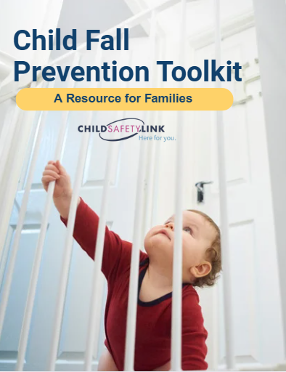

Safety and Installation Tips
Take at look at:
Child Safety Link: Fall Prevention Toolkit
Installation information
Using baby gates safely
Fall prevention information
Notes:
If you'd like more information, take a look at the Safety At Home: Fall Prevention Guide
The guide includes information on childhood falls, fall prevention, baby gate installation, and using baby gates safely.
(send to families via email)

Slide 26
Questions?

Slide 27





FIND & CONTACT US
childsafetylink@iwk.nshealth.ca
childsafetylink.ca
1-866-288-1388
@childsafetylink

